Slide 1
Acute fatty liver of pregnancy
Maryam Yazdani MD
Bahman 1402

Slide 2
Case1 Department of Obstetrics and Gynaecology, University of Zimbabwe, College of Health Sciences, Harare, Zimbabwe
An 18year old primiparous with an estimated gestational age (EGA) of 35+6w.
referral from a local clinic in preterm labour.
generally unwell for 4days , nausea, vomiting and yellowing of the eyes for the same duration with no pruritus.
No past medical HX. Finding .P/E:W.N.L.
NVD. :WT:2300 / Apgar 9/10, no sever hemorrhage.

Slide 3
After 48 hr: WBC:(26 to 50 cells/mm3/ haemoglobin (11.1 to 4.7g/dl)
Platelets (PLT) remained normal (189-221× 103).
LFT: alkaline phosphatase (ALP) (331 to 277IU/L) and gamma glutamyl transpeptidase (GGT) (228 to 206IU/L) with minimally elevated aspartate aminotransferase (AST) (39 to 52U/l) and alanine aminotransferase (ALT) (48 TO 39 U/l).
Total bilirubin was not available.
Hepatitis A and B were negative.
hypoglycaemia (1.1–2.3mmol/l) which were corrected with 50% dextrose followed by infusion of 10% dextrose 8 hourly

Slide 4
The clinical condition of the patient deteriorated on the third day post-delivery as she became confused and she started vomiting coffee ground material.
The patient deceased on the 3rd day post-delivery.
The neonate was referred to paediatricians for ongoing care.
Post mortem and histology results confirmed the diagnosis.

Slide 5
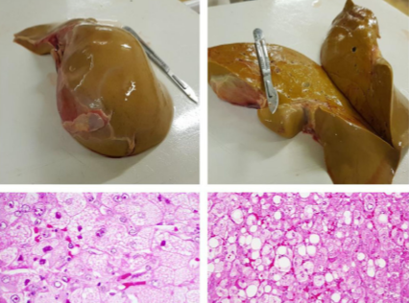

Slide 6
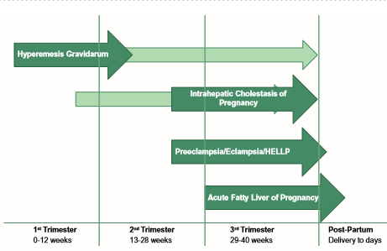

Slide 7
case2
A 24 years old G1L0, G/A 34 W, refer to private clinic and complain of N/V and malaise . Medical history no specific finding and Physical exam W.N.L.
To R/O EARLY HELLP Syndrome , LFT was done : liver enzyms upper nl. l. others w.n.l.
CBC: Hb: 12.3g/dl WBC: 8000/dl PLT: 110,000/dl
kidney function test: BUN:15 Creatinine: 0.8
Supportive treatment for acute viral hepatitis A was given at a private clinic.

Slide 8
Next week she referred with , worsening epigastric pain .
In physical examination: hypertensive ? Bp:120/80 previous: 100/70
Liver function test : AST 40 mg/dl ALT 41mg/dl ,bilirubin: 2mg/dl
Kidney function test : w.n.l .
Complete blood count : PLT: 100,000/dl
Standard serologic tests : negative for hepatitis.
She admitted in perinatology unit for close observation . Daily Fetal monitoring with ultrasonography and , fetal heart monitoring was ordered.

Slide 9
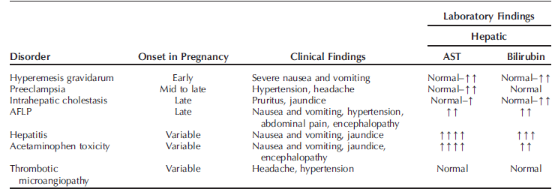

Slide 10
Lab data in second day of admission:
L.F.T.: mild increase in liver enzymes42-41mg/dl, bilirubine: 3.8
K.F.T: serum creatinine1.1mg/dl / BUN:27
C.B.C: Hg:11g/dl/ PLT:100,000/ WBC:9100,PT:13
NST: reactive
Ultrasonograpgy: BPP:8/10 . A.F .I: 7 cm/

Slide 11
In 3rd day of hospital admission,
She was icteric, with mild edema of the legs.
NST shows persistent variable decelation .
Ultrasonography : decreased turbid amniotic fluid . (May be infavore of meconium contamination )
Termination of pregnancy was decided.

Slide 12
Complete blood counts revealed a hemoglobin: 11g/ dl, white blood cell count: 10,400/cumm, and platelet count: 57,000/cumm.no hemolysis PT : 60 seconds. fibrinogen: 62 mg/dl, and fibrin degradation products (FDP): 360 μg/ml. .
serum (LDH) levels were 238 mg%.
L.F.T.: aspartate aminotransferase: 208 U/l, alanine aminotransferase: 304 U/l, total bilirubin: 8.3 mg/dl, direct bilirubin: 6.7 mg/dl, alkaline phosphatase: 532 U/l, albumin: 2.6 g/dl.

Slide 13
Kidney function test: blood urea: 40 mg/dl, serum creatinine: 1.5 mg/dl, mg/dl, and serum ammonia: 106 μmol/L.
serum glucose: 60
Urine analysis showed mild proteinuria.
Serology tests like HBsAg, HCV, and HIV were all negative.
A presumptive diagnosis of pre-eclampsia with HELLP and/or AFLP was made.

Slide 14
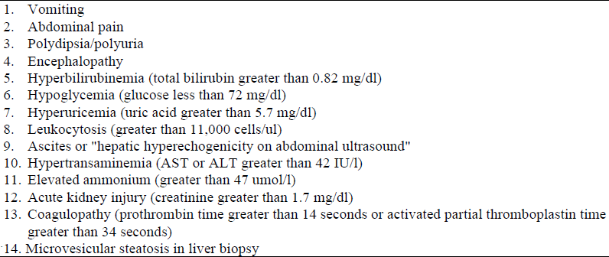
Swansea criteria

Slide 15
Clinical and laboratory features of HELLP vs. AFLP.

Slide 16
Imaging
1) ultrasonography: increased echogenicity, 25%
2) computed tomography: subjectively decreased attenuation. highest yield they reported was 50%
3) MRI: increased signal in the T1-weighted image.
When R/0 hematoma, mass,intraperitonial hemorrhage.

Slide 17
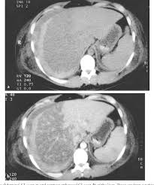

Slide 18
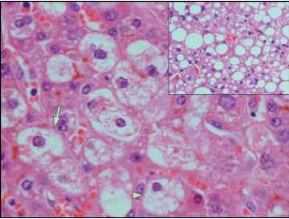

Slide 19
LSCS was performed under general anesthesia a male fetus with APGAR score 1-7 was delivered , and admitted in NICU.
before which she received 10mg vitamin K, four units of platelet-rich plasma, and 10 units of cryoprecipitate to correct her coagulopathy.
Intraoperative, right internal jugular vein was cannulated and she received 1000ml crystalloids, six units (FFP), and two units of packed red cells. Her estimated blood loss was 600 ml.
As her urinary output (u/o) was 50 ml and central venous pressure (CVP) remained between 8 and 10 mmHg, she was given 40 mg furosemide, after which her u/o increased to 100 ml.

Slide 20
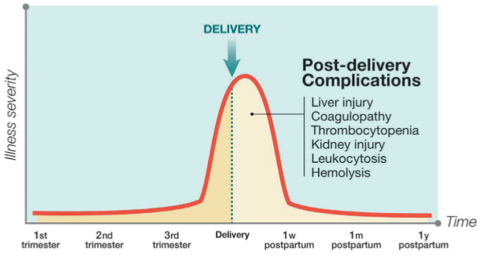
Trajectory of illness

Slide 21
She was shifted to the ICU in view of the altered liver function, renal failure, and disseminated intravascular coagulation (DIC), and was put on broad-spectrum antibiotics.
Twelve hours following admission to ICU she became markedly tachycardic and tachypnoeic.
Chest X-ray revealed pulmonary edema.

Slide 22
ICU course
Since the patient was in acute renal failure with a urine output less than 25 ml/hour, she was dialyzed.
For the next three days, she required intermittent dialysis for uraemia and replacement of blood components to correct coagulopathy.

Slide 23
ICU COURSE
Due to increasing respiratory distress and hypoxia, she was kept on controlled mechanical ventilation on day 4 of ICU admission. Chest X-ray at this point was suggestive of acute respiratory distress syndrome (ARDS) and she required high positive end-expiratory pressure (PEEP) to maintain PaO₂ > 60 mmHg for 10 days.

Slide 24
ICU COURSE
Her blood culture was positive for pseudomonas for which she received antibiotics as per culture and sensitivity report.
Her bilirubin and liver enzymes started to decrease and platelets increased from day 10. During this period, she received 20 units of packed red blood cells (PRBC), 30 units of FFP, 40 units of platelets, and 20 units of cryoprecipitate to maintain an INR of <1.5, a platelet count of >50000/cumm, and fibrinogen >100 gm/dl.

Slide 25
ICU COURSE
She made a gradual recovery and was weaned off from the ventilator on day 30 of admission to the hospital.
Her liver and kidney function returned to normal and she was discharged on day 40.

Slide 26
Acute pancreatitis
About 15% of women with acute fatty liver of pregnancy develop acute pancreatitis that can be severe. This pancreatitis is treated conservatively with nasogastric suction and analgesics.
Another complication is transient diabetes insipidus, which is thought to be due to an elevated vasopressinase concentration caused by diminished production of the inactivating enzyme by the liver. In some cases desmopressin will be successful in reversing prodigious diuresis.

Slide 27
Newborn
Screening for enzyme defects
Hypoglycaemia
Encephalopathy , coma
Death

Slide 28
Long term outcome
Retinopathy
Cardiomyopathy
Metabolic crises
Hypotonia and muscle pain

Slide 29
Contraception considerations for women with pre-existing and gestational liver disorders.

Slide 30
POSTPARTUM LIVER FAILURE
For some women with persistent liver failure, postpartum artificial liver support therapy is employed.
These methods include plasma exchange, which removes toxins, improves electrolyte management, supports coagulation factors, and improves acid–base balance.
Another treatment option is plasmapheresis, which may result in improvement of oxidative stress markers and hasten hepatic function recovery; however, plasmapheresis has not reduced mortality.

Slide 31
EXTRACORPOREAL LIFE SUPPORT SYSTEMS
Extracorporeal life support systems been used as salvage therapy for a number of organ system failures in pregnant women. Extracorporeal membrane oxygenation is primarily used for cardiovascular and respiratory failure, but it has also been employed in acute liver failure.
We have used it successfully in one woman with severe hypotension from liver failure when other supportive measures had failed.
Molecular absorbent recirculating system is another method of supportive care, or as a bridge to liver transplantation, in patients with acute liver failure.This method functionally replaces the liver in removing albuminbound toxins from the blood through albumin dialysis, which results in stabilization of liver function and improvement in hyperbilirubinemia .

Slide 32
LIVER TRANSPLANTATION

Slide 33
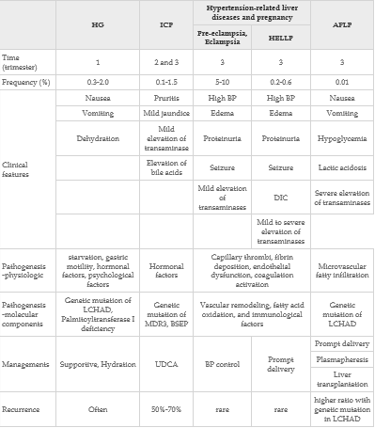
Classification of pregnancy-related liver disease

Slide 34
ACG Clinical Guideline: Liver Disease and Pregnancy.American Journal of Gastroenterology 10.1038/ajg.2016430
Acute Fatty Liver of Pregnancy .2021 by the American College of Obstetricians and Gynecologists
Acute Fatty Liver of Pregnancy in the ICU.anesthesia, intensive care unit journal 2021
Pregnancy and liver disease,journal of hepatology 2015
Advances in understanding and treating liver diseases during pregnancy: word journal of GI
EASL clinical practice guidelines on the management of liver disease in pregnancy , journal of hepatology 2023
Annals of hepatology.2019
Management hepatic complications of pregnancy:practical strategiesfor clinicians .BMJ2
Maternal Fetal medicine. 2014

